Slide 1
Introduction
Symmetric matrices appear naturally in many applications:
The numerical solution to ordinary and partial differential equations.
The theory of quadratic forms.
The matrix representation of undirected graphs.
Principal component analysis in statistics.

Slide 2
Introduction
Symmetry allows the development of algorithms for solving certain problems more efficiently than the same problem can be solved for a general matrix.
Computation of eigenvalues and their associated eigenvectors can be done accurately and with a lower flop count than their determination for a general matrix.

Slide 3
The Symmetric Eigenvalue Problem
The eigenvalues of a symmetric matrix are real, and the eigenvectors can be assumed to be real.

Slide 4
THE Symmetric Eigenvalue Problem
A symmetric matrix has real eigenvalues and can always be othogonally diagonalized, regardless of whether it has multiple eigenvalues.
Can always find P such that P^{T}AP = D.
This is not true for general matrices.

Slide 5
The Symmetric Eigenvalue Problem
Another special property of real symmetric matrices is that the computing eigenvalues is a well-conditioned problem. We can compute them with assurance that the errors will be small.

Slide 6
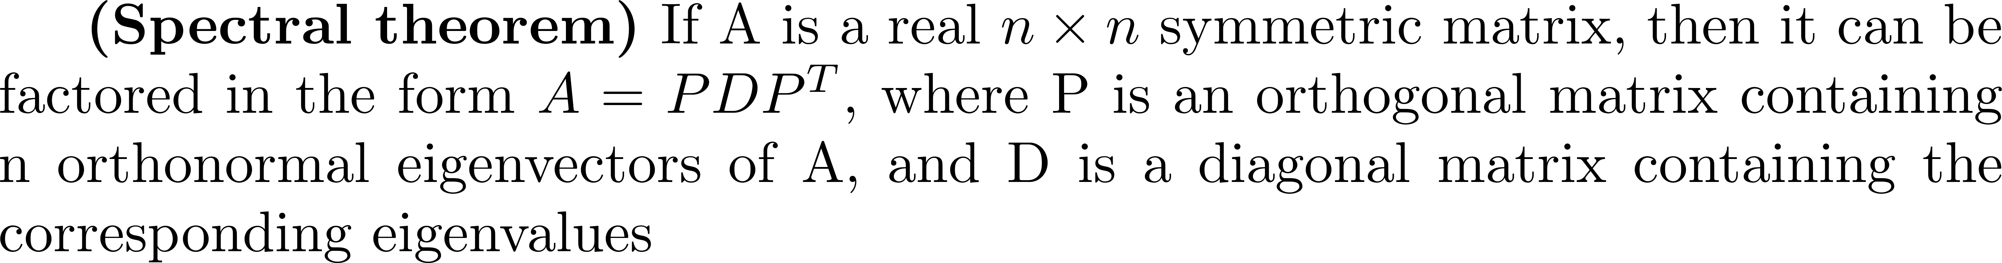
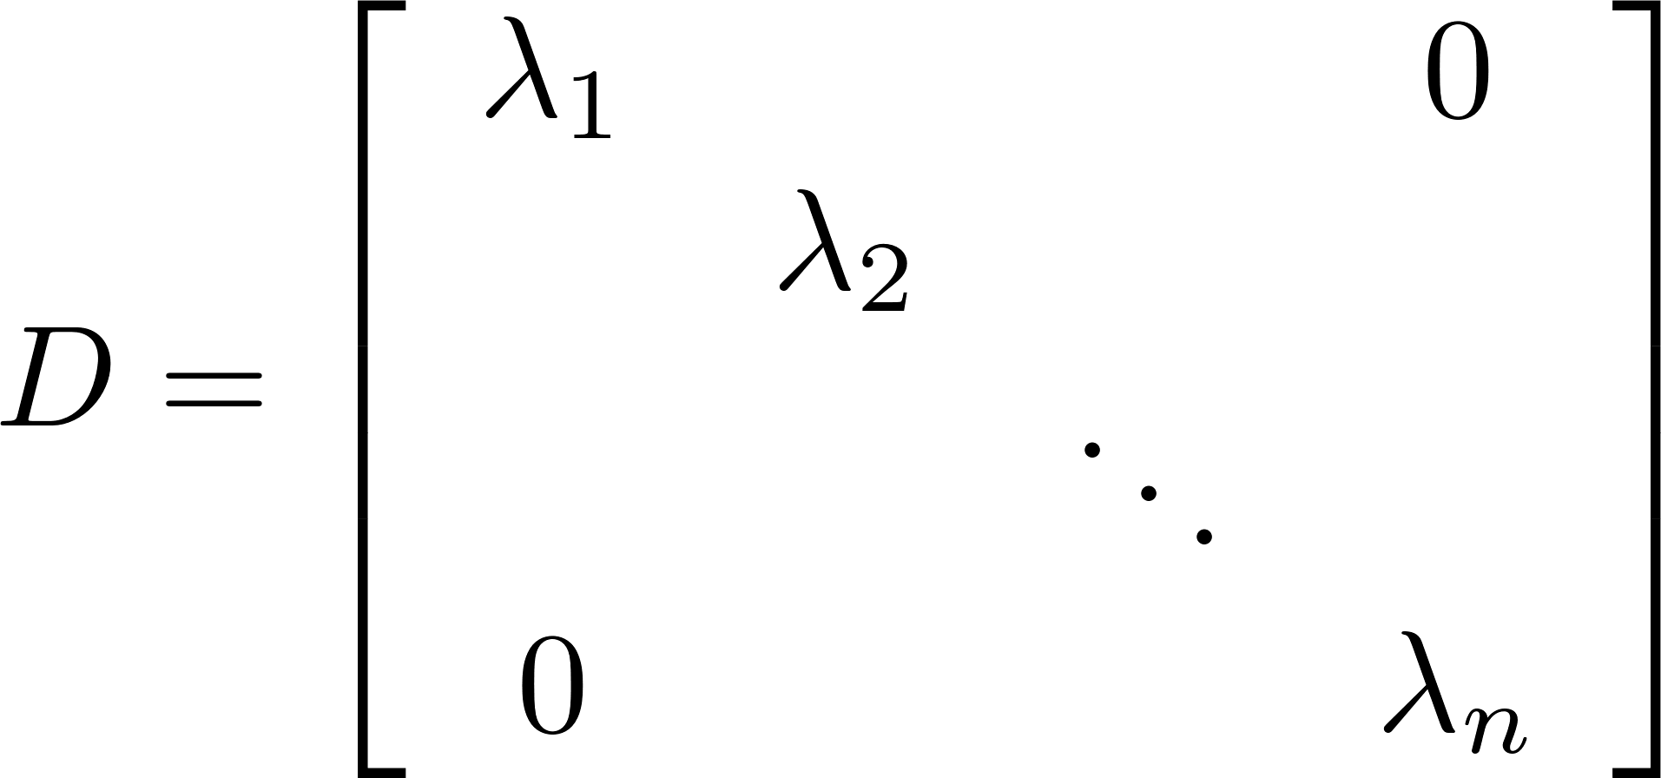
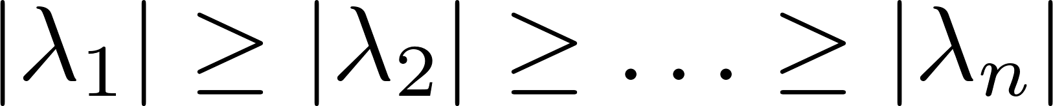
The Spectral Theorem
The proof uses Schur's triangularization.
Can arrange P so its columns contain eigenvectors that correspond to the eigenvalues in decreasing order of magnitude.

Slide 7
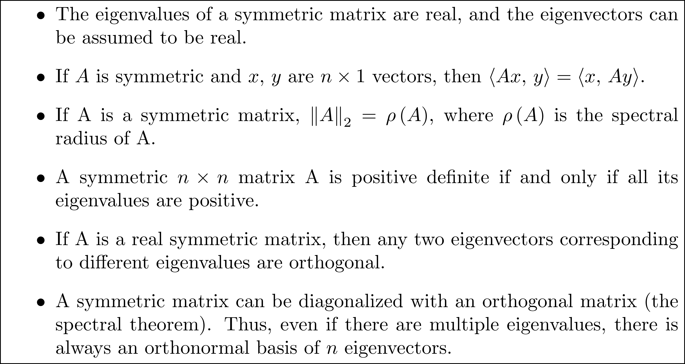
Properties of a Symmetric Matrix
Properties Previously Developed

Slide 8
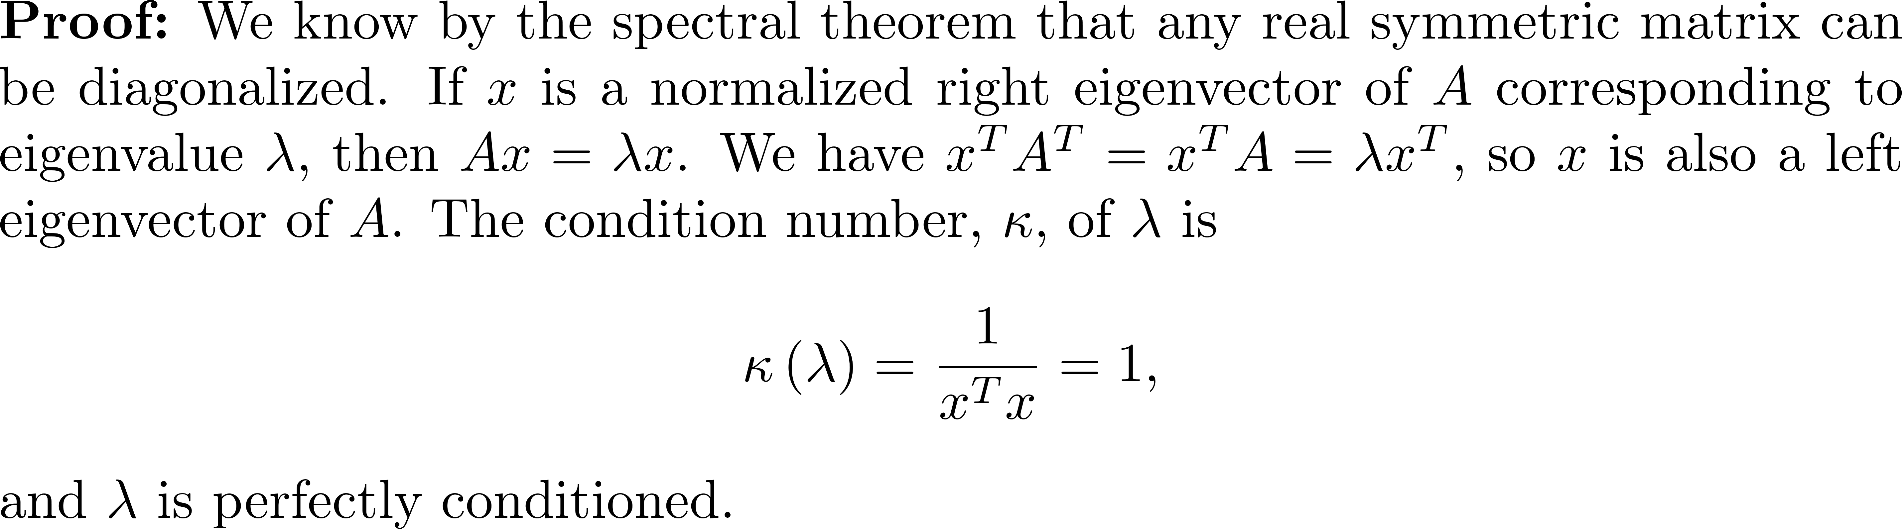
Properties of a Symmetric Matrix
The eigenvalues of a real symmetric matrix are well-conditioned.
Good news for computing eigenvalues, but eigenvectors can be ill-conditioned.

Slide 9
The Jacobi Method
The strategy used by the Jacobi method is to develop an iteration that will reduce the sum of the squares of the entries off the diagonal, thus gradually obtaining a nearly diagonal matrix whose diagonal entries are approximations to the eigenvalues of A.

Slide 10
The Jacobi Method
Define
Generate a sequence of orthogonal similarity transformations that successively reduce off(A) until A is nearly a diagonal matrix.

Slide 11
The Jacobi Method
Each orthogonal matrix P_{k} is produced by a Givens rotation, slightly different from the rotations used in when computing the QR factorization. Each similarity transformation is chosen so that zeros zeros-out the pair of elements a_{ij} and a_{ji}.

Slide 12
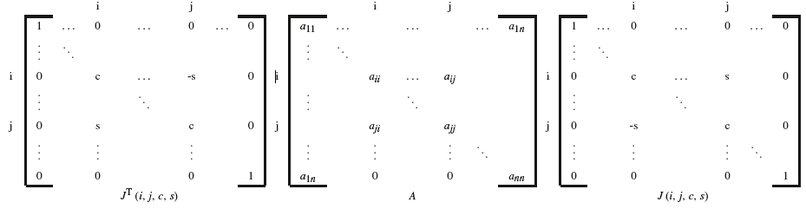
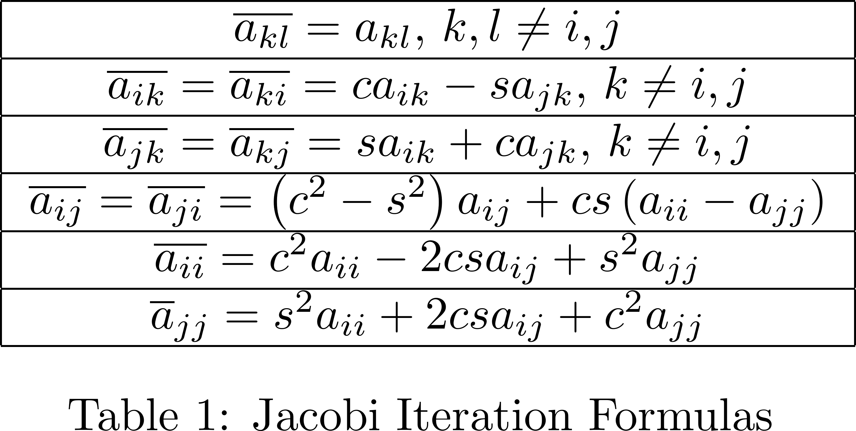
The Jacobi Method
In looking at patterns emerge:

Slide 13
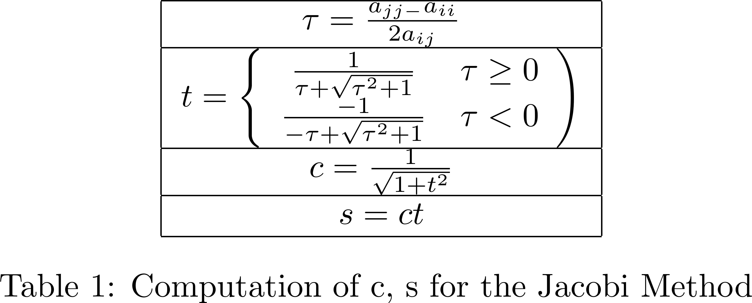
Computation of c and s
Set that results in
After some analysis, compute c and s as follows:

Slide 14
Convergence of the Jacobi Method
At each iteration, choose for a_{ij} the off-diagonal element largest in magnitude. With this strategy, the Jacobi method converges. Each iteration of the Jacobi algorithm makes a_{ij} and a_{ji} zero, and the computation to do this can destroy pairs of zeros already created. However, as the iteration progresses, off(A) decreases, leaving approximations to the eigenvalues on the diagonal.

Slide 15
The Cylic-by-Row Jacobi Algorithm
Computing requires O(n) flops, but searching for the off diagonal element largest in magnitude costs flops.
This is simply too expensive, so it is almost never used in practice.
The alternative is the cyclic-by-row Jacobi algorithm.

Slide 16
The Cylic-by-Row Jacobi Algorithm
Compute off(A) by cycling through the entries above the diagonal by rows left-to-right as follows:
One cycle of N Jacobi rotations is termed a sweep, and sweeps are performed until off(A_{k}) is sufficiently small.

Slide 17
Computing Eigenvectors using the Jacobi Iteration
The iteration computes so maintain the product

Slide 18
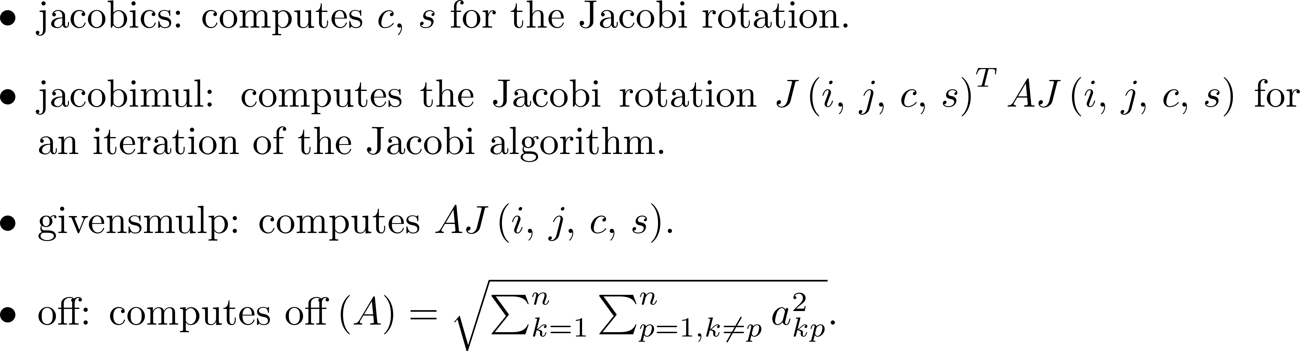
Introduction to Algorithm eigsymj
Assume the following functions are available:

Slide 19
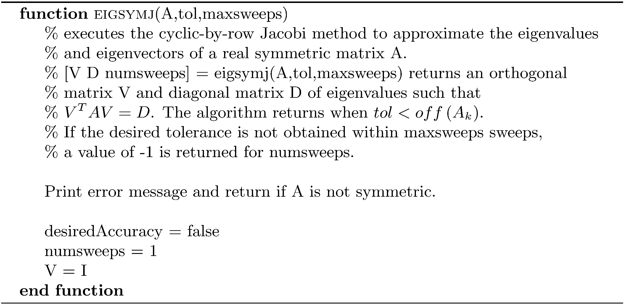
Jacobi Method for the Real Symmetric Matrix Eigenproblem

Slide 20
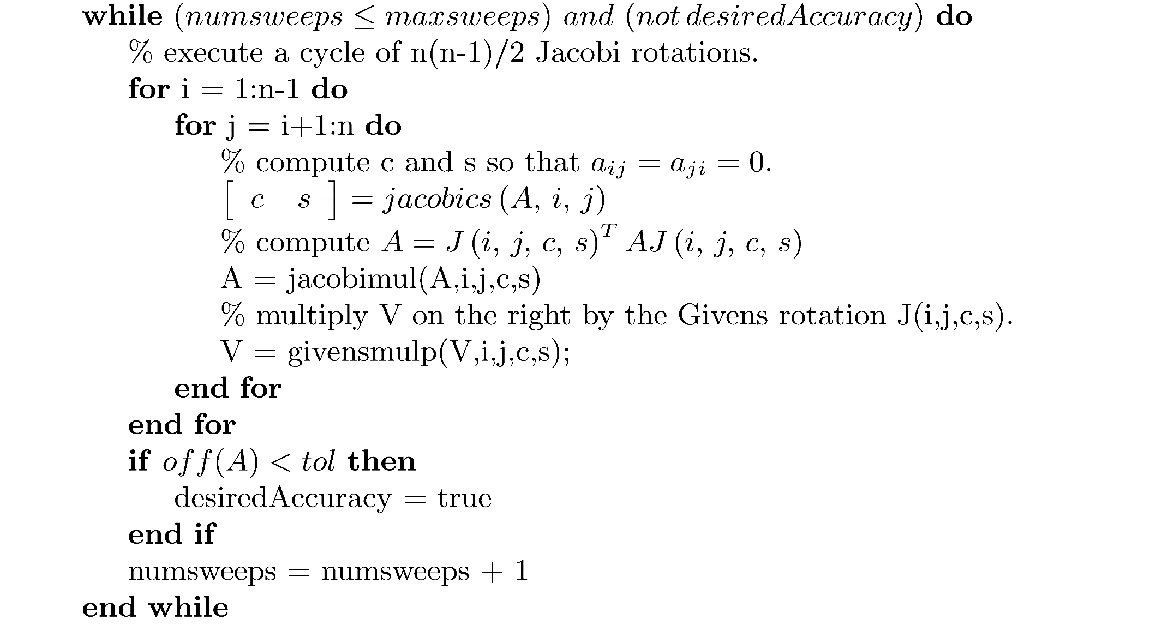
Jacobi Method for the Real Symmetric Matrix Eigenproblem

Slide 21
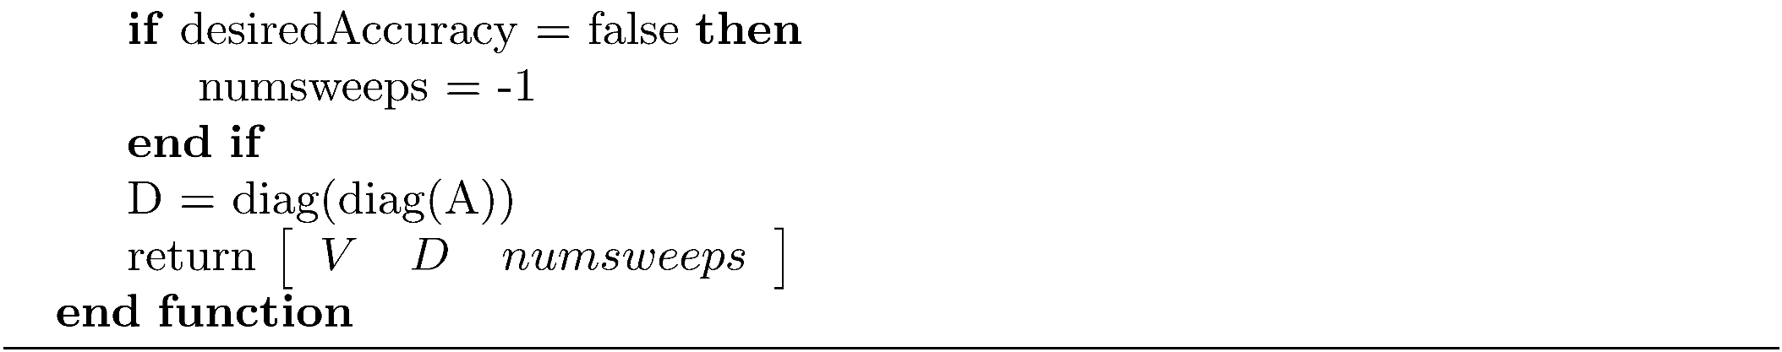
Jacobi Method for the real Symmetric Matrix Eigenproblem

Slide 22
Example 1
This example demonstrates that a symmetric matrix can have ill-conditioned eigenvectors. The symmetric matrix EIGVECSYMCOND from the software distribution has a condition number of 70.867. The following MATLAB program clearly demonstrate that the eigenvectors are ill-conditioned.

Slide 23
Example 1
load 'EIGVECSYMCOND.mat';
[V1,D1,sweeps1] = eigsymj(EIGVECSYMCOND,1.0e-14,20);
E = 1.0e-10*rand(25,1);
E = diag(E);
EIGVECSYMCONDP = EIGVECSYMCOND;
EIGVECSYMCONDP = EIGVECSYMCONDP + E;
[V2,D2,sweeps2] = eigsymj(EIGVECSYMCONDP,1.0e-14,20);
fprintf('norm(D1-D2) = %g\n',norm(D1-D2));
fprintf('norm(V1-V2) = %g\n',norm(V1-V2));
<Output>
norm(D1-D2) = 1.16415e-10
norm(V1-V2) = 0.884624

Slide 24
The Symmetric QR Iteration Method
The first step, as for a general matrix, is to perform an orthogonal similarity transformation to upper Hessenberg form. If a matrix is symmetric, upper Hessenberg form is a tridiagonal matrix.
Need to develop an efficient way to take advantage of symmetry when reducing A to a tridiagonal matrix.

Slide 25
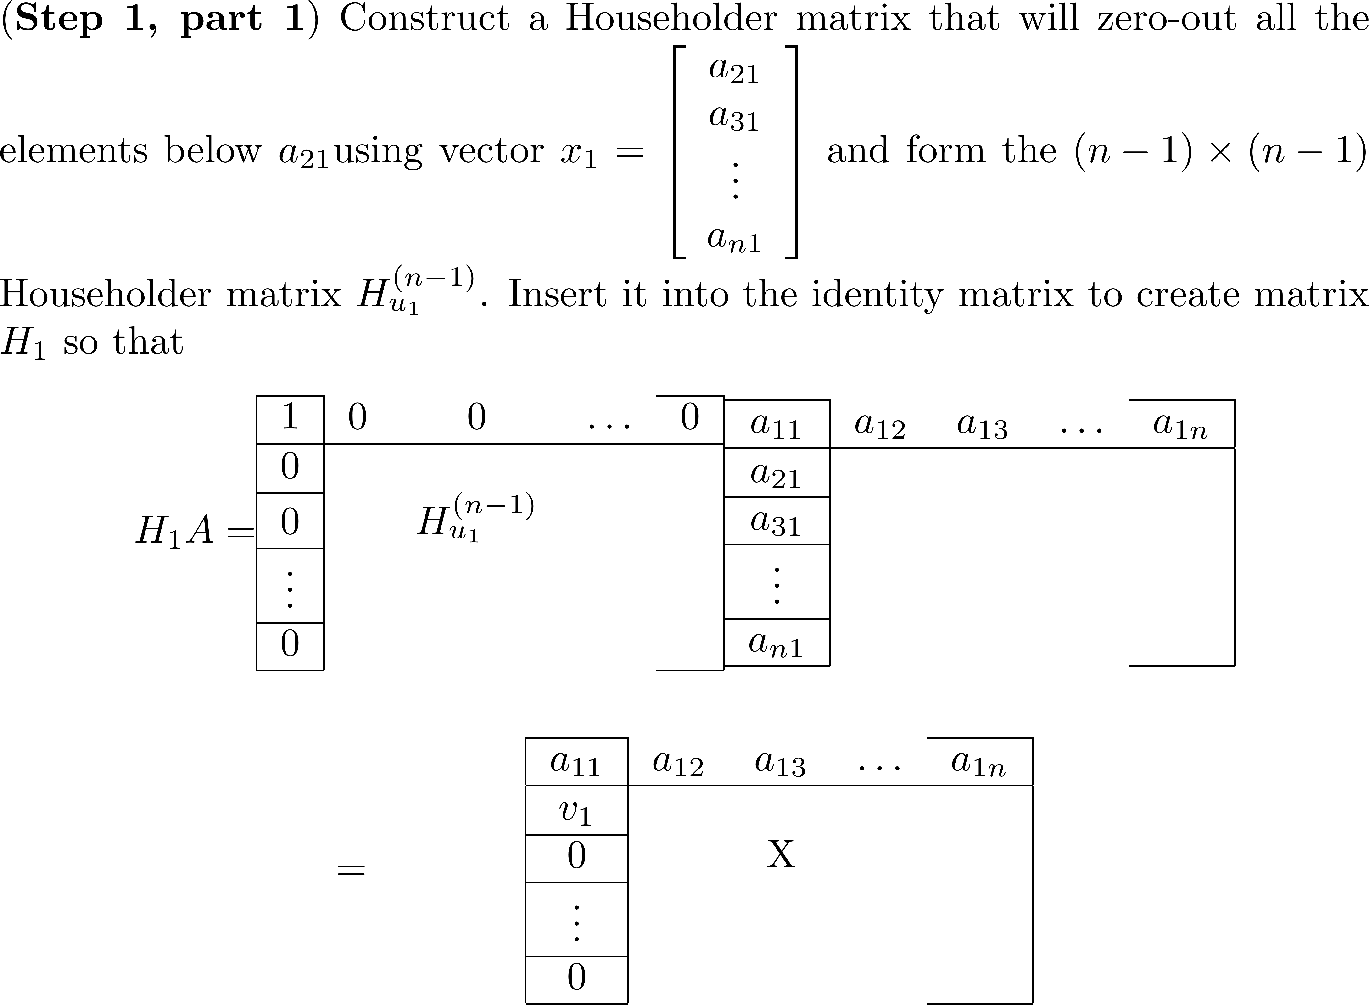
The Symmetric QR Iteration Method
Use Householder matrices for the orthogonal similarity transformations.

Slide 26
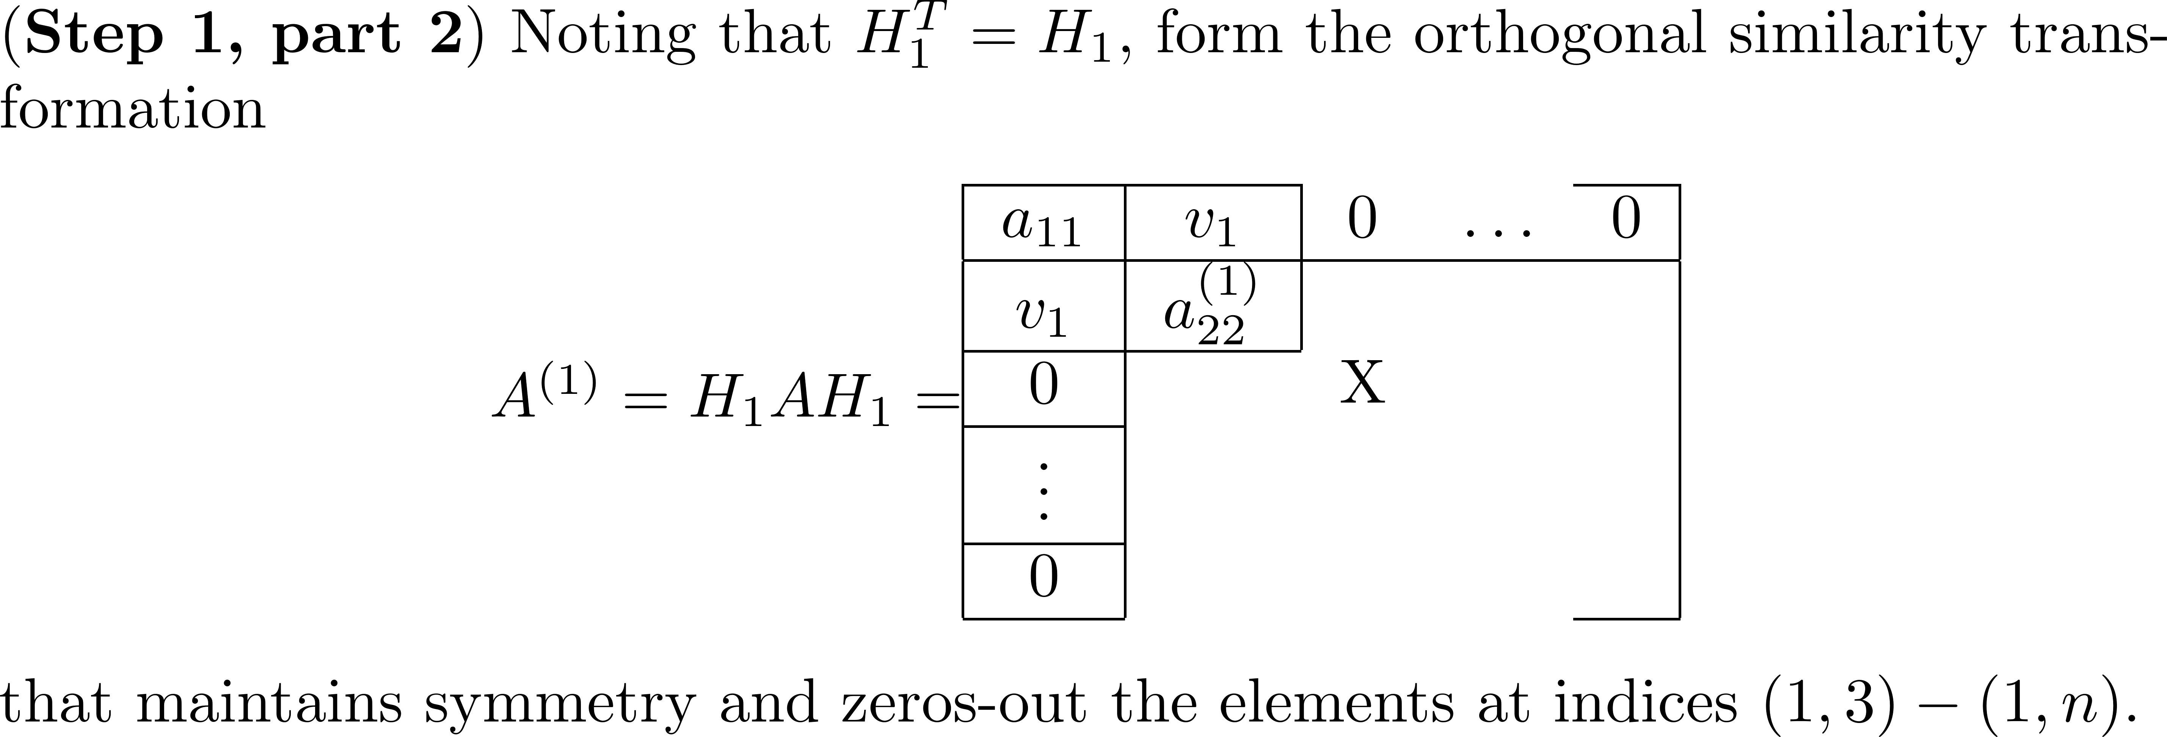
The Symmetric QR Iteration Method

Slide 27
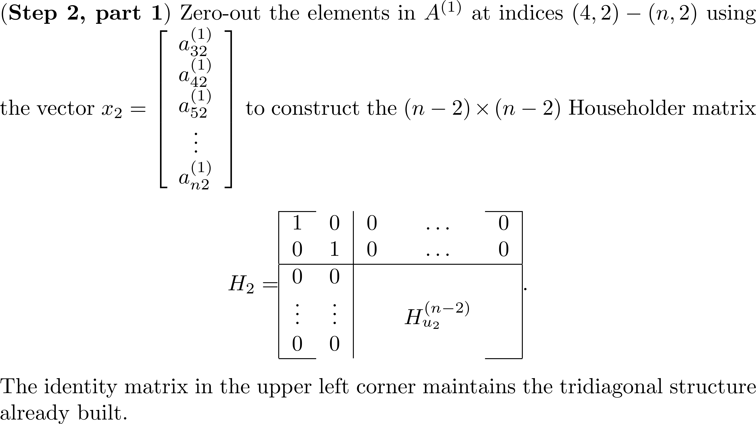
The Symmetric QR Iteration Method

Slide 28
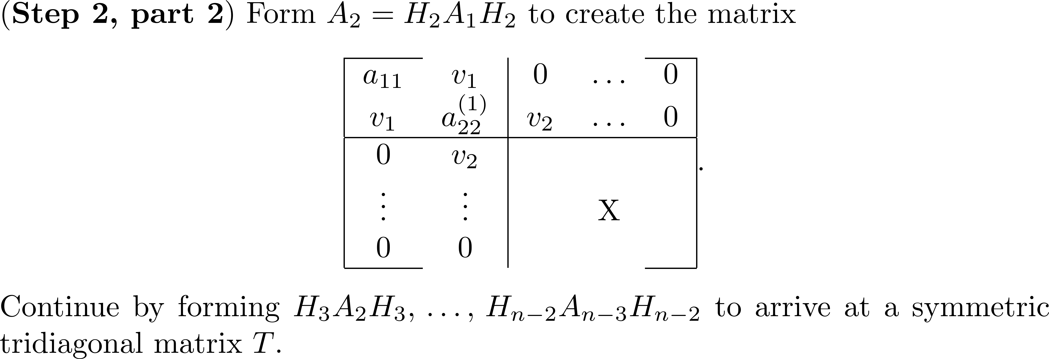
The Symmetric QR Iteration Method

Slide 29
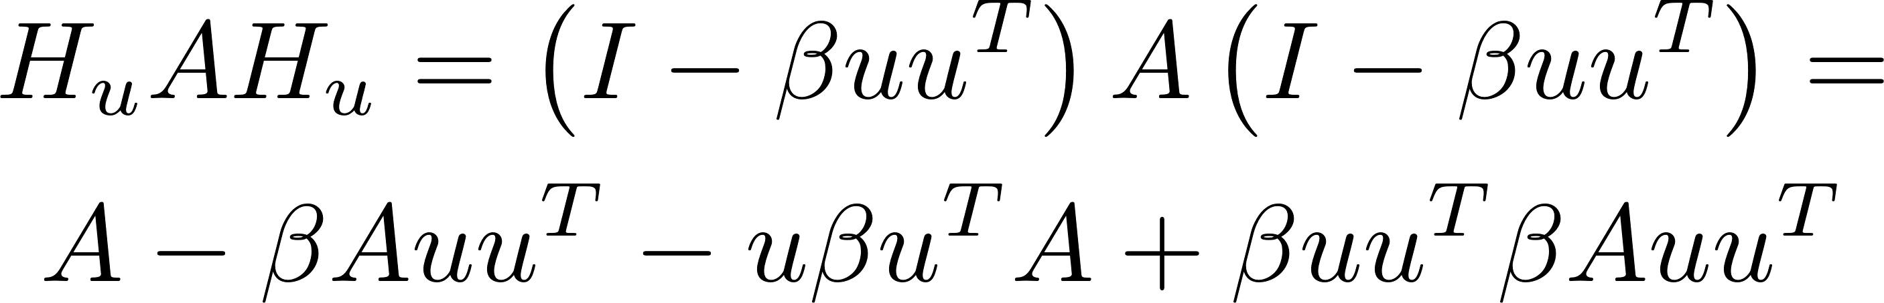
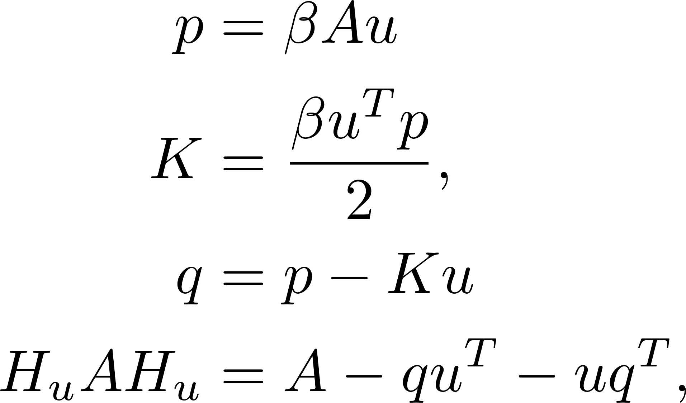
Tridiagonal Reduction of a Symmetric Matrix
It should not be necessary to construct the entire matrix, H_{i} having the i × i identity matrix in the upper left-hand corner. The product H_{i}A_{i-1}H_{i} should be done implicitly and take advantage of symmetry.
Starting with and making some definitions gives

Slide 30
Tridiagonal Reduction of a Symmetric Matrix
Each iteration H_{i}AH_{i} affects only the submatrix A( i+1:n,i+1:n ) , so there is no need to deal with any other portion of the matrix.
Assign the values a_{i+1,i} , a_{i,i+1} and then perform the product
After completion of the n-2 iterations, place zeros above and below the three diagonals to eliminate small entries remaining due to roundoff error.

Slide 31
Tridiagonal Reduction of a Symmetric Matrix
If P is required, compute using the formula

Slide 32
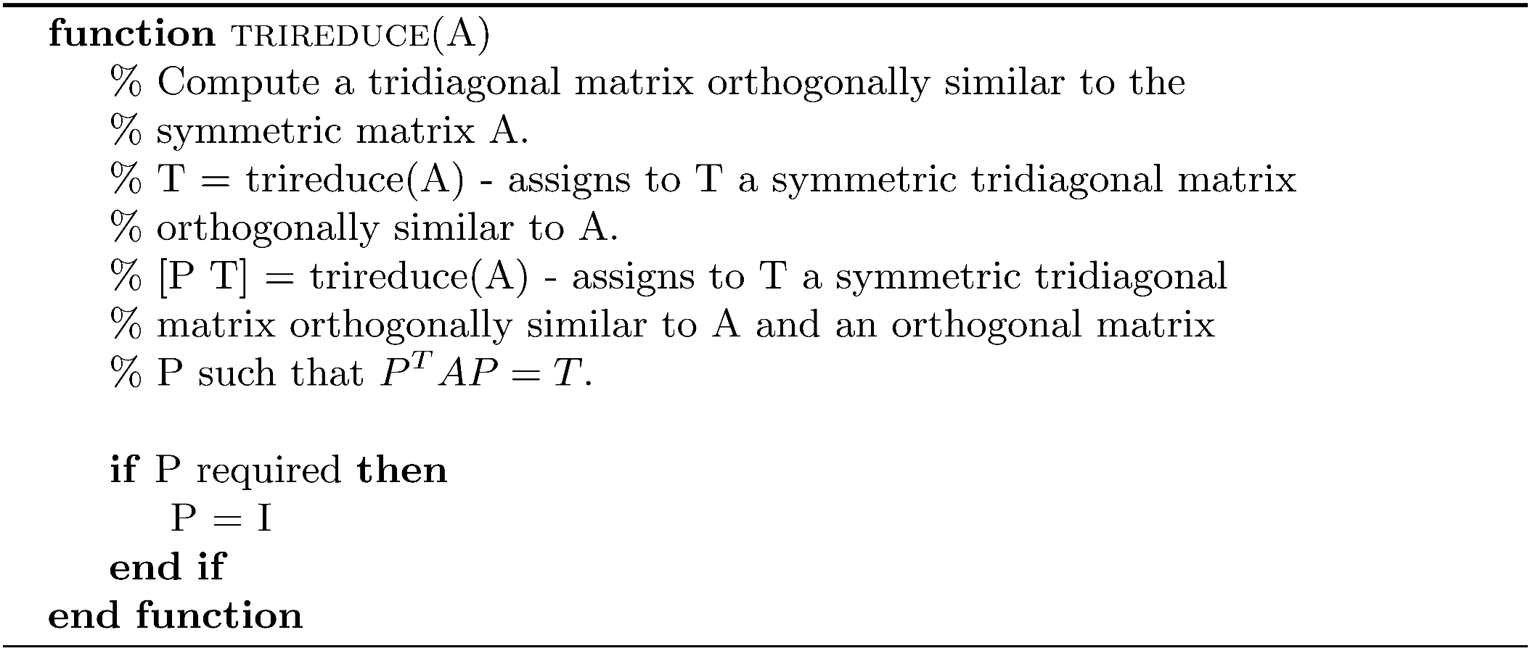
Algorithm trireduce

Slide 33
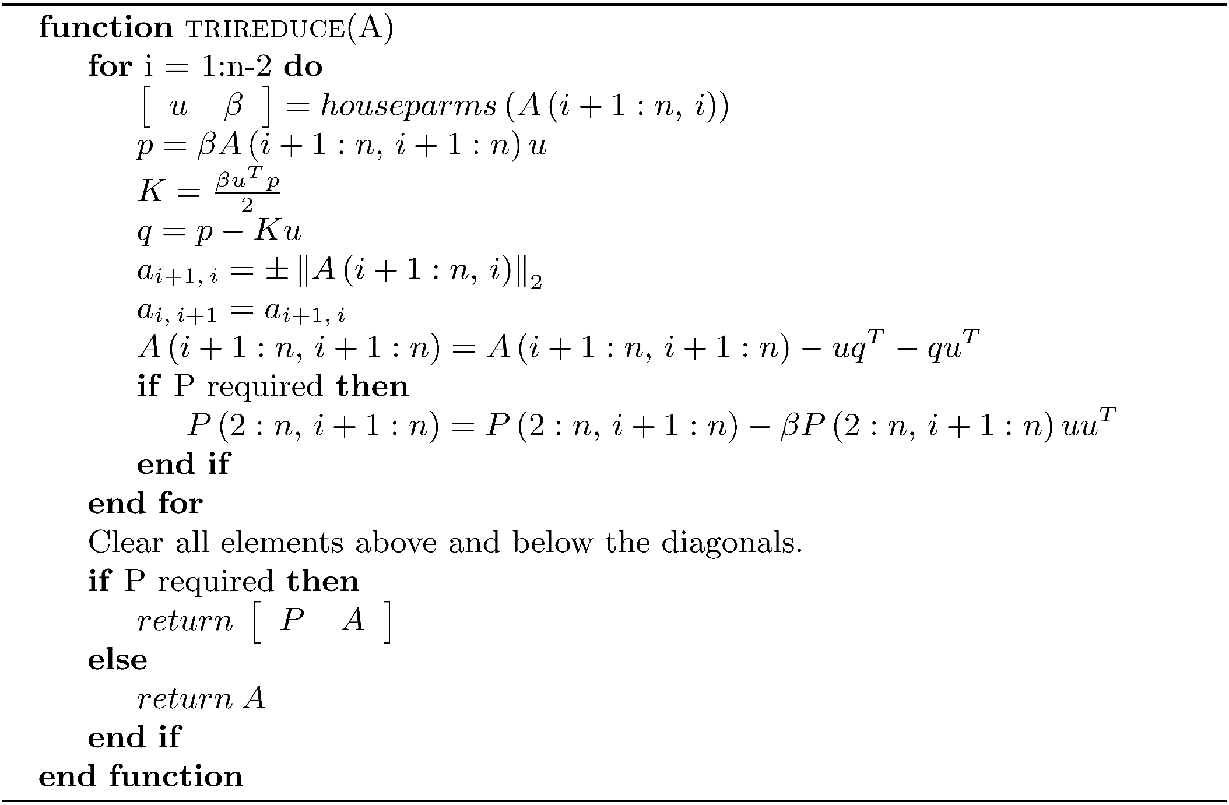
Algorithm trireduce
The reduction to tridiagonal form requires 4/3n³ flops, and the algorithm is stable

Slide 34
Example 2
>> A = rosser;
>> [P T] = trireduce(A);
>> norm(P*T*P'-A)
ans =
3.011579656732004e-12
>> EA = sort(eig(A));
>> ET = sort(eig(T));
>> norm(EA - ET)
ans =
1.947250757104605e-12

Slide 35
Orthogonal Transformation to a Diagonal Matrix
The problem is reduced to computing the eigenvalues and possibly eigenvectors of a symmetric tridiagonal matrix. There are two approaches:
Use an explicit single shift with deflation.
Use the single shift version of the Francis algorithm (implicit QR).

Slide 36
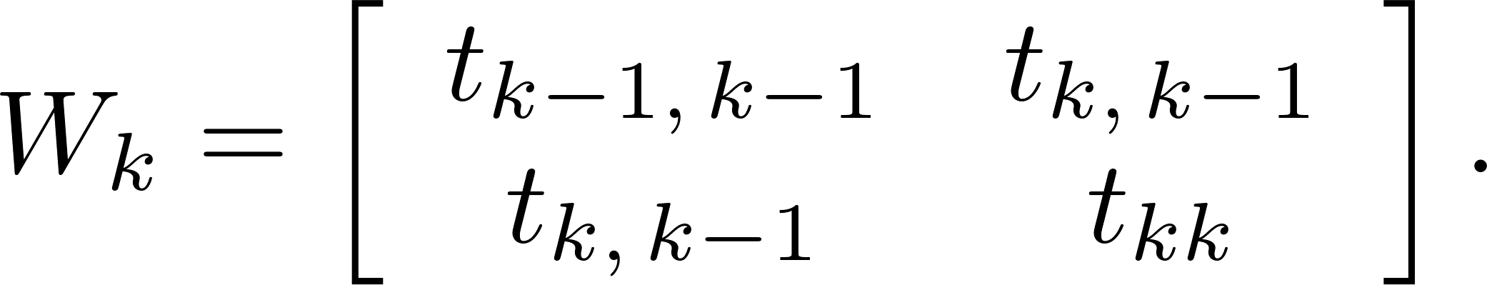
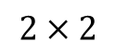
Orthogonal Transformation to a Diagonal Matrix
An explicit shift strategy
Compute the QR decomposition of the matrix T_{k} - σI = Q_{k}R_{k} and form T_{k+1} = R_{k}Q_{k} + σ I. R_{k}Q_{k} is a symmetric tridiagonal matrix.
With a symmetric matrix, use the Wilkinson shift, a properly chosen eigenvalue of the lower matrix
$$2×2$$

Slide 37
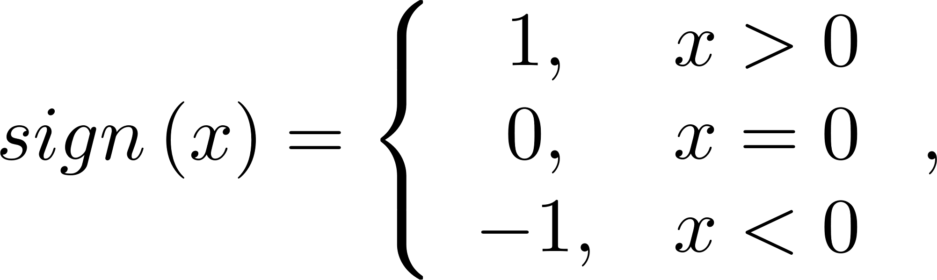
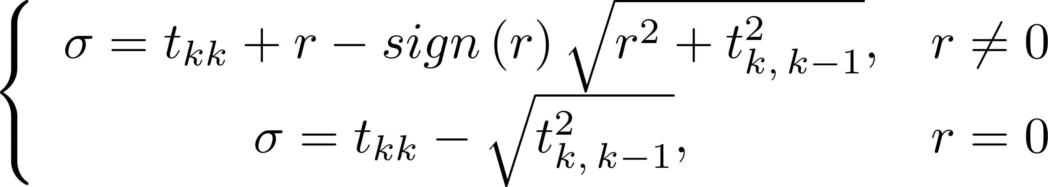
Orthogonal Transformation to a Diagonal Matrix
Wilkinson Shift
The eigenvalue
closest to t_{kk}.
Convergence when the using the Wilkinson shift is guaranteed to be at least linear,
but in most cases is cubic.

Slide 38
eigsymqr
The MATLAB function eigsymqr uses trireduce to transform A into a symmetric tridiagonal matrix. Following this, the matrix is orthogonally transformed to an approximate diagonal matrix using the Wilkinson shift.

Slide 39
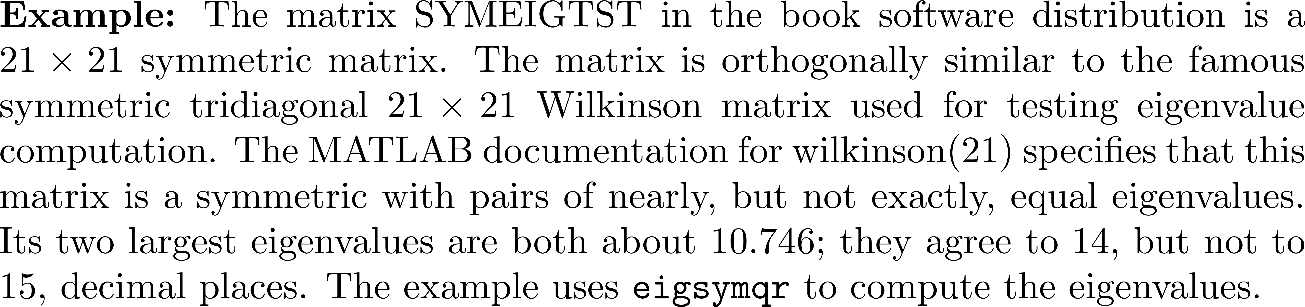
Example 3
>> load SYMEIGTST
eigsymqr(SYMEIGTST,1.0e-14,50)
ans =
-1.125441522119974
0.253805817096685
0.947534367529301
...
5.000244425001915
6.000234031584169
6.000217522257100
...
10.746194182903356
10.746194182903350

Slide 40

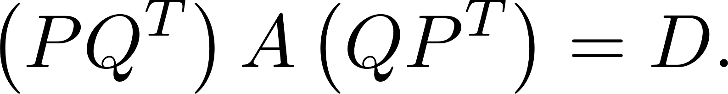
The Symmetric Francis Algorithm
After transforming A to a symmetric tridiagonal matrix , apply the single shift implicit QR algorithm using the Wilkinson shift and transform A into a diagonal matrix Let , and

Slide 41
eigsymb
The MATLAB function eigsymb finds the eigenvalues and, optionally, the eigenvectors of a symmetric matrix. The function chase(T) discussed in Chapter 18 performs the bulge chase. Like eigsymqr, eigsymb uses deflation so it only works on submatrices.

Slide 42
Example 4
>> A = rosser;
>> [V,D] = eigsymb(A,1.0e-14,75);
>> diag(D)
ans =
1.0e+03 *
-1.020049018429998
0.000098048640722
0.000000000000000
1.020049018429997
1.020000000000000
1.019901951359278
1.000000000000001
1.000000000000000
>> norm(V*D*V'-A)
ans =
3.291880068524273e-12
>> norm(V)
ans =
1.000000000000000

Slide 43
The Bisection Method
The bisection method for finding the roots of a nonlinear function is very reliable.
If f is a continuous real-valued function on an interval left ≤ x ≤ right with f(left) and f(right) having opposite signs ( f(left)f(right)<0 ), then there must be a value r in the interval such that f(r)=0 . r is a root of f .
Divide the interval in half. If r is not at the midpoint, mid, it must be to the left (f(left)*f(mid) < 0) or to the right (f(left)*f(mid) > 0). Adjust left and right accordingly and repeat until |right-left| is as small as desired.

Slide 44
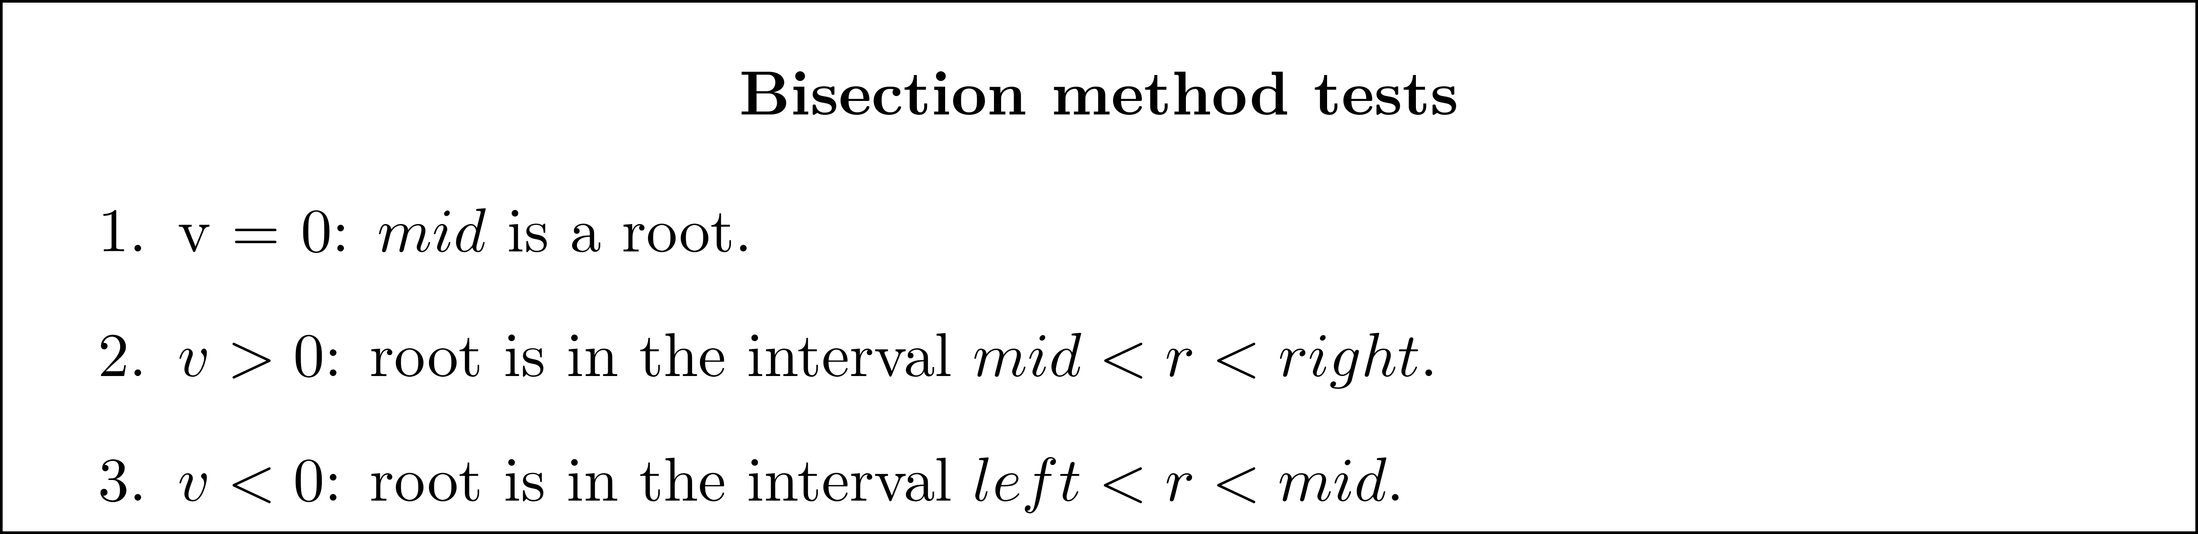
The Bisection Method
>

Slide 45
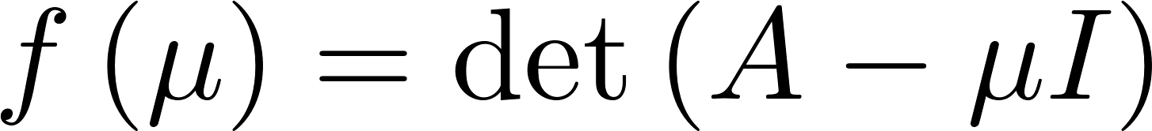
The Bisection Method
If , the eigenvalues of A are the roots of f.
Find two values μ_{l} = left and μ_{r} = right for which f(left)f(right)<0, and apply the bisection algorithm.
Deals only with the value of f, not its coefficients, and det can be evaluated stably using the LU decomposition with partial pivoting.
What makes the use of bisection extremely effective when applied to a symmetric tridiagonal matrix is some extraordinary properties of its eigenvalues and f( μ ).

Slide 46
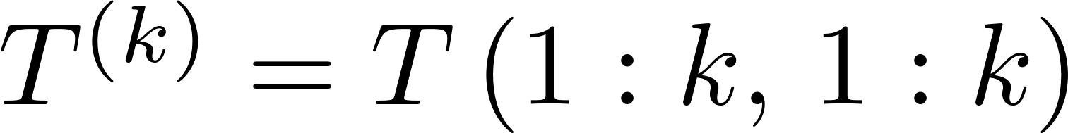

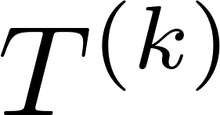
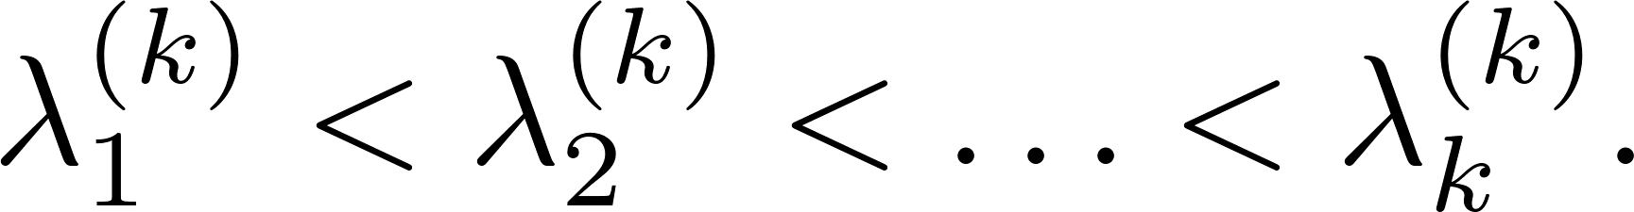
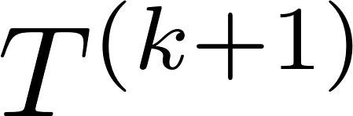
The Bisection Method
Assume T is a symmetric, unreduced, tridiagonal matrix. Let be the upper-left submatrix of T. The eigenvalues of are distinct, and assume they are
The eigenvalues of two successive matrices and strictly interlace, or

Slide 47
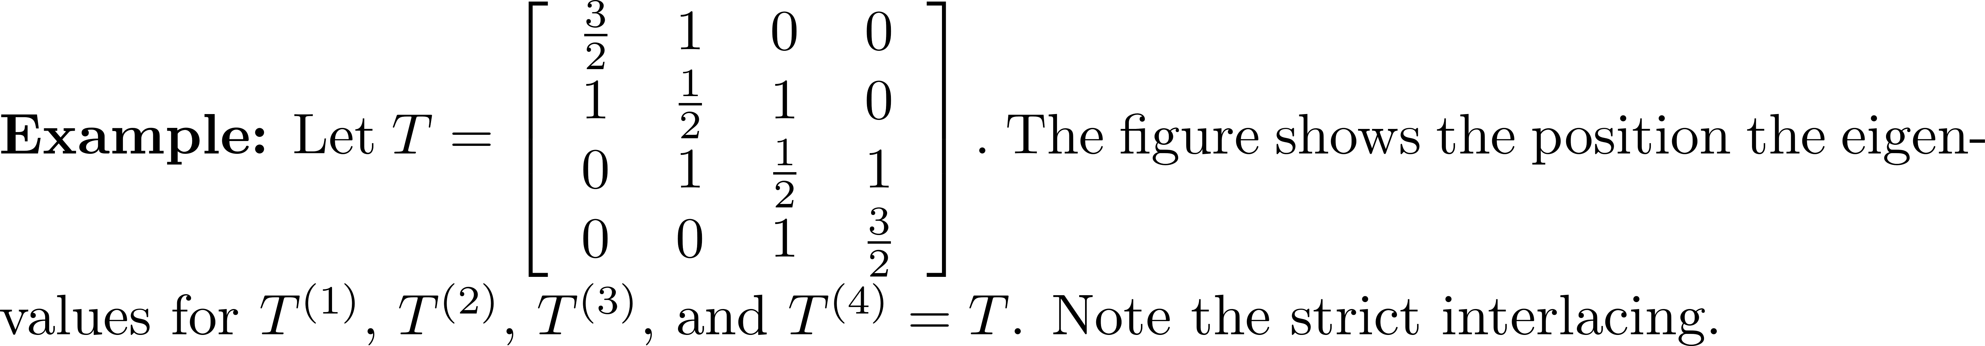
The Bisection Method
Interlacing tells us the precise number of eigenvalues in any interval of the real line.

Slide 48
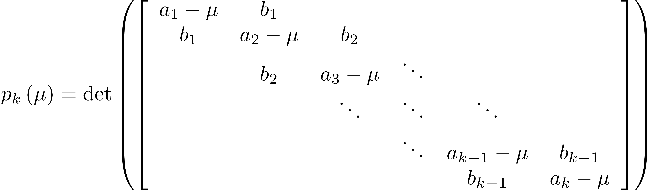
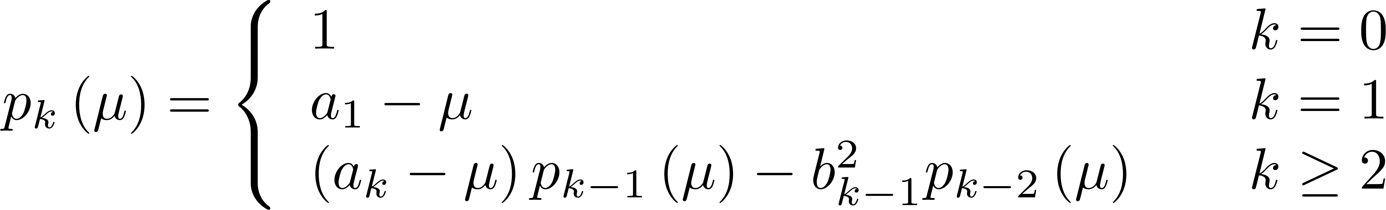
The Bisection Method
Can evaluate using and avoiding Gaussian elimination.

Slide 49
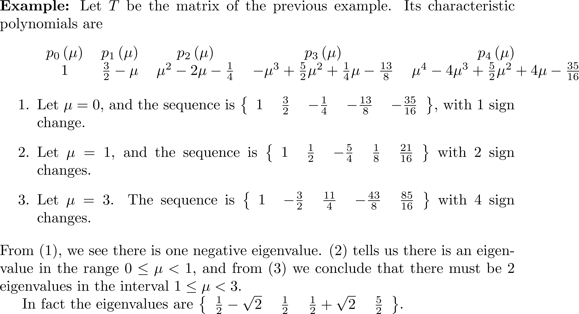
The Bisection Method

Slide 50
The Bisection Method
Use the infinity norm to obtain starting values
If p_{k}( ) = 0, define the sign of p_{k}( ) to be the opposite of that for p_{k-1}( ). There cannot be two consecutive zero values in the sequence.

Slide 51
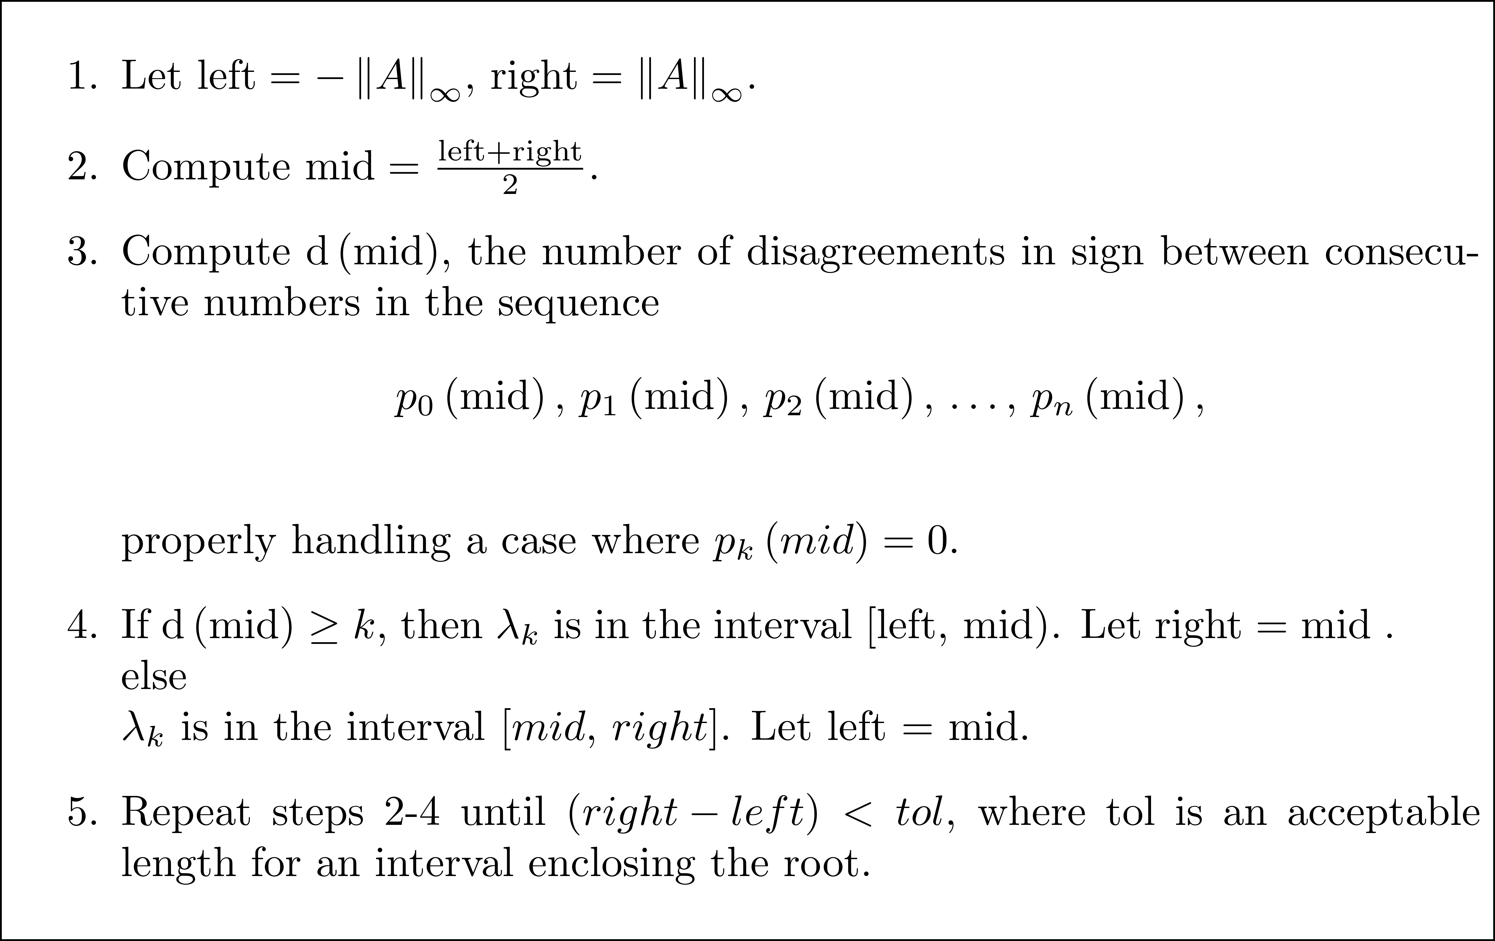
Bisection Method Algorithm Outline

Slide 52
Bisection Method Algorithm Outline

Slide 53
Example 5
>> W = wilkinson(21);
>> lambda20 = bisection(W,20,1.0e-14)
lambda20 =
10.746194182903317
>> lambda21 = bisection(W,21,1.0e-14)
lambda21 =
10.746194182903395
>> lambda1 = bisection(W,1,1.0e-14)
lambda1 =
-1.125441522119983

Slide 54
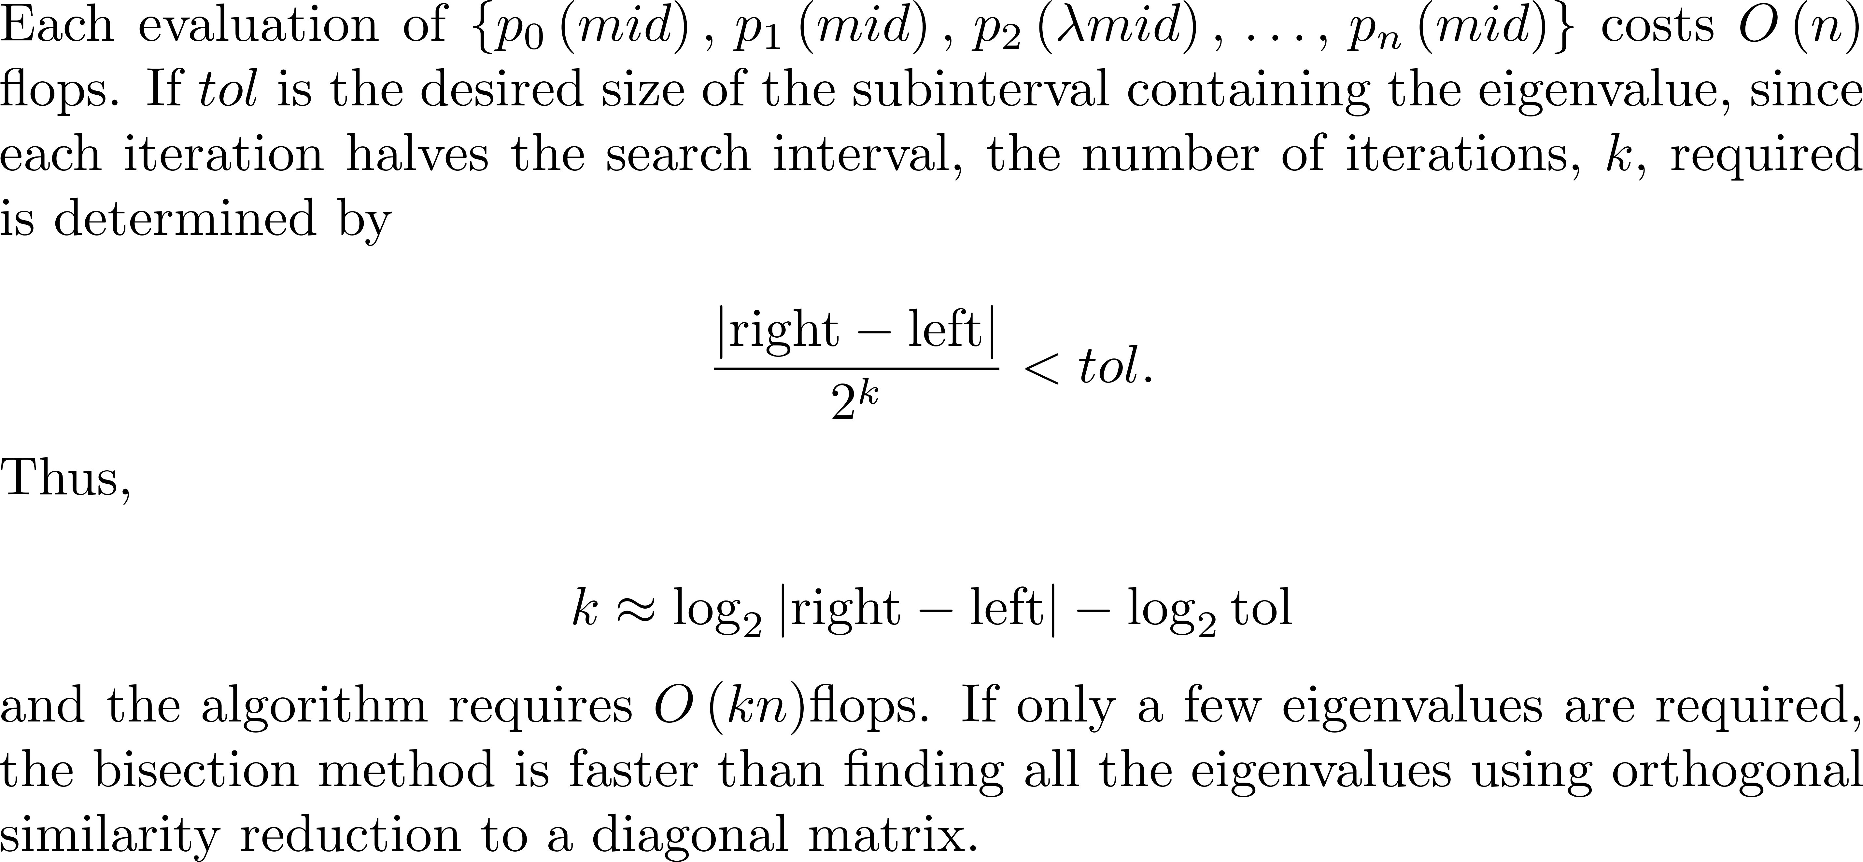
Bisection Method Efficiency

Slide 55
Divide-and-Conquer Method
The recursive algorithm divides a symmetric tridiagonal matrix into submatrices and then applies the same algorithm to the submatrices.

Slide 56
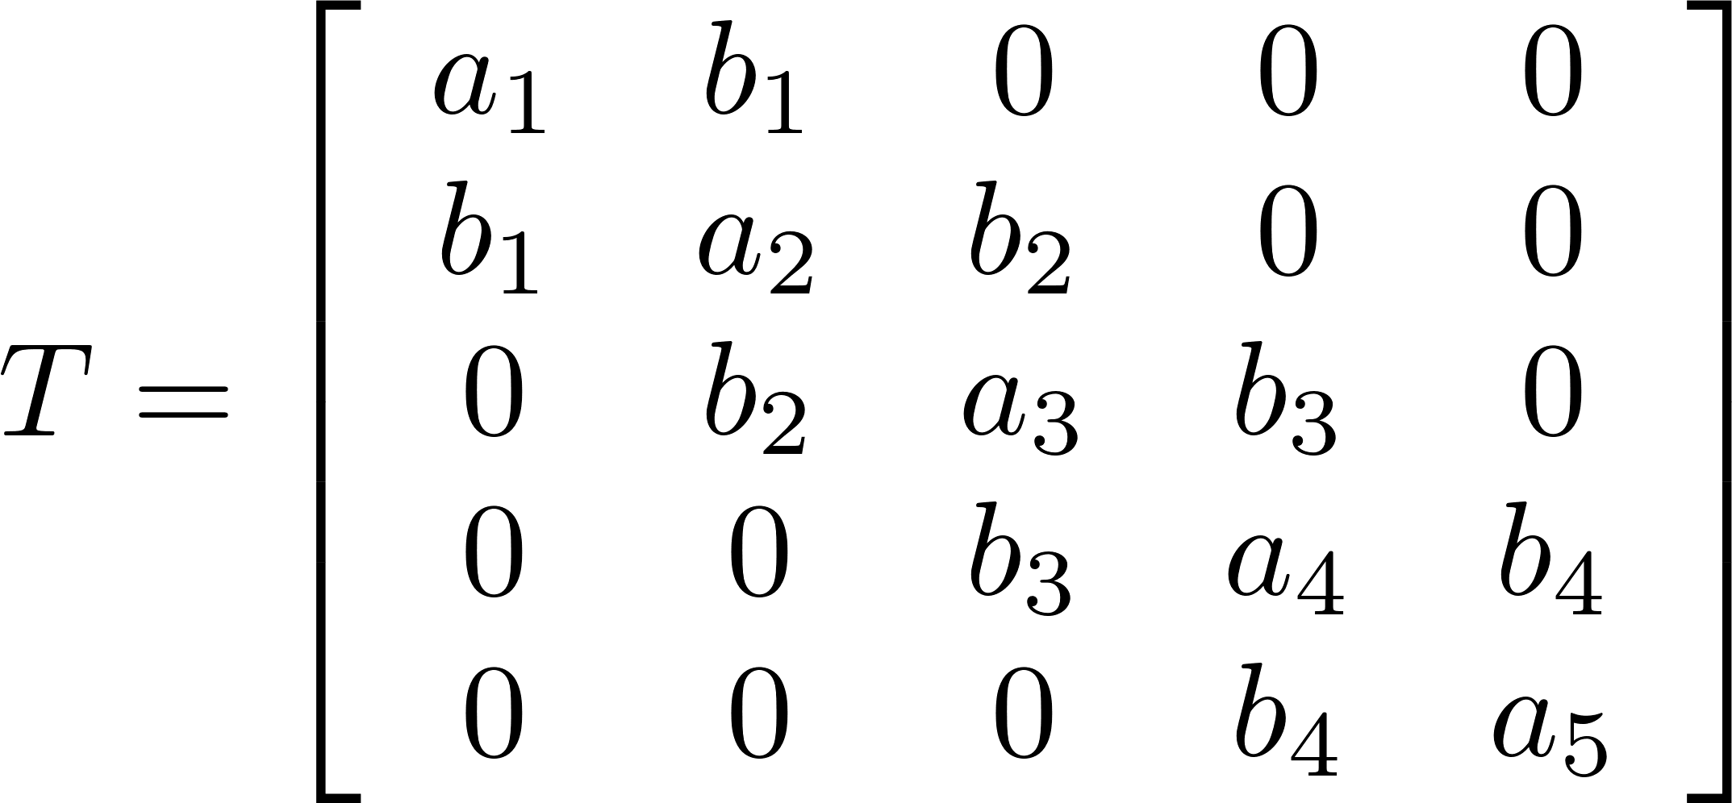
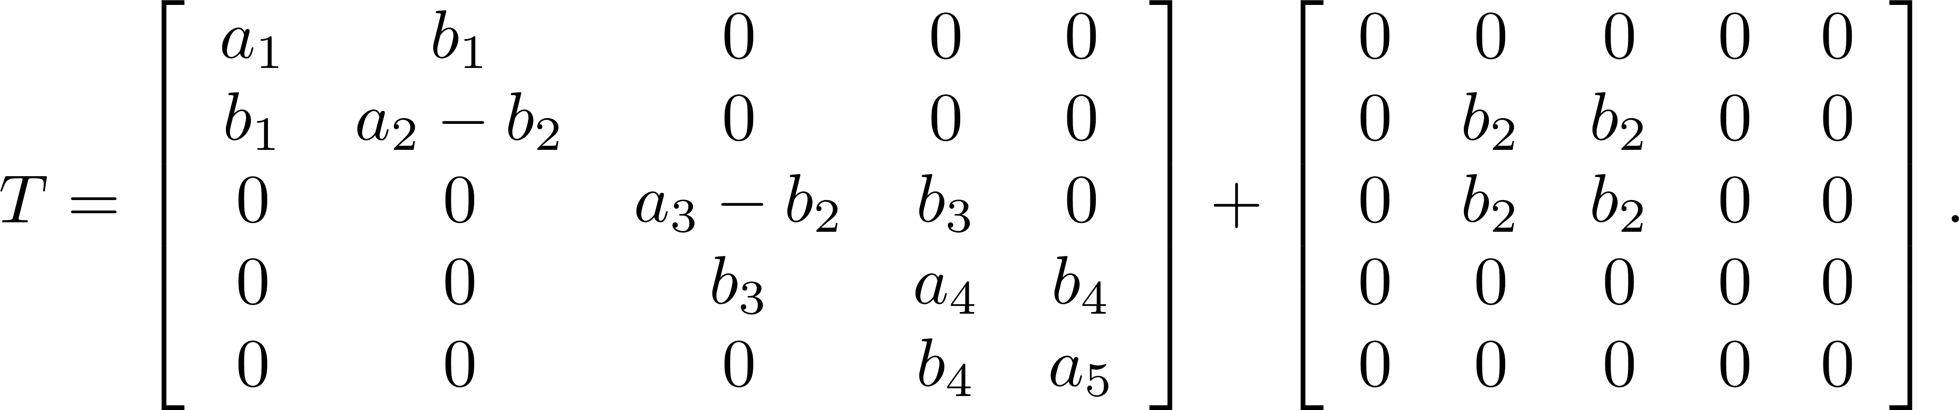
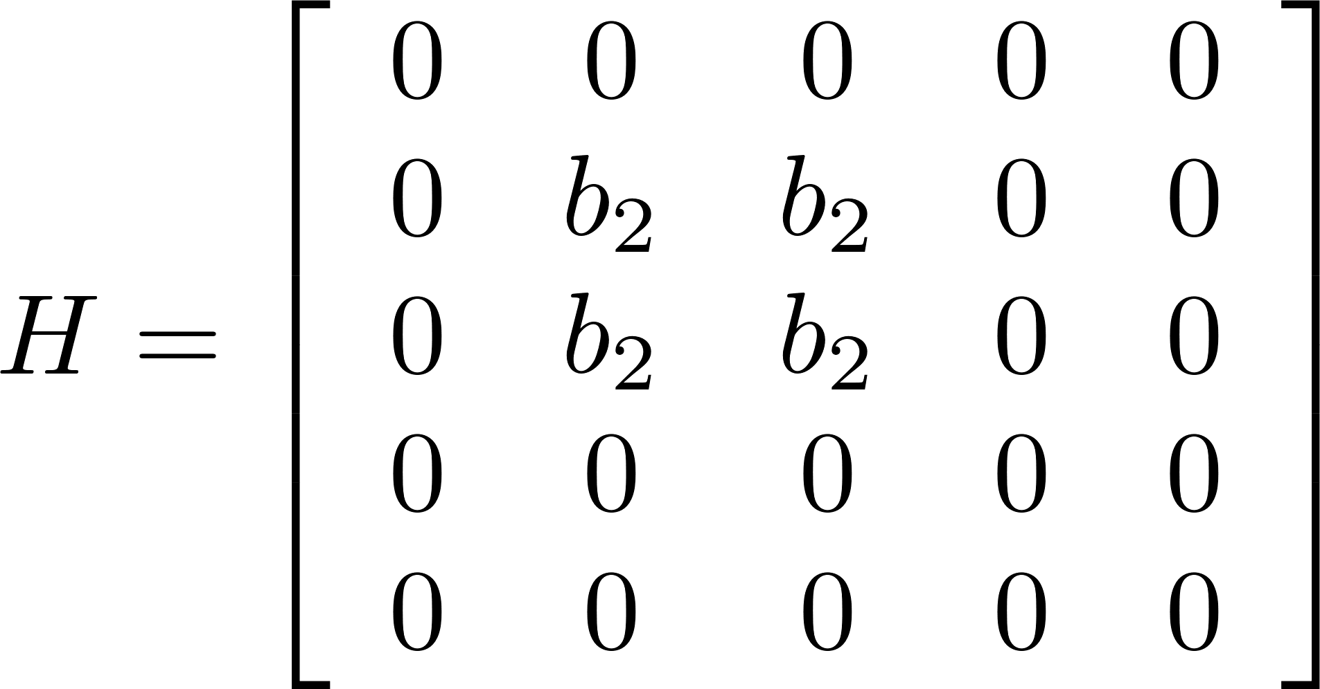
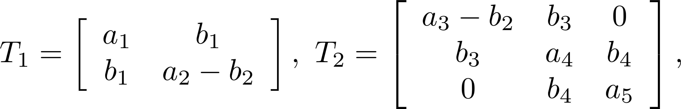
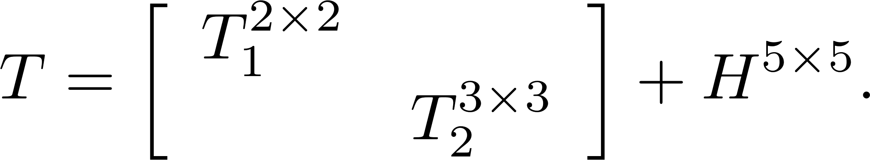
Divide-and-Conquer Method 5 5 Example
Let
Then
Symmetric, triagonal
Rank 1 matrix

Slide 57
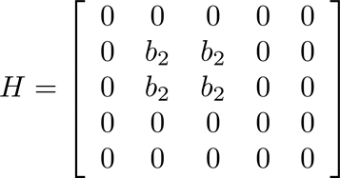
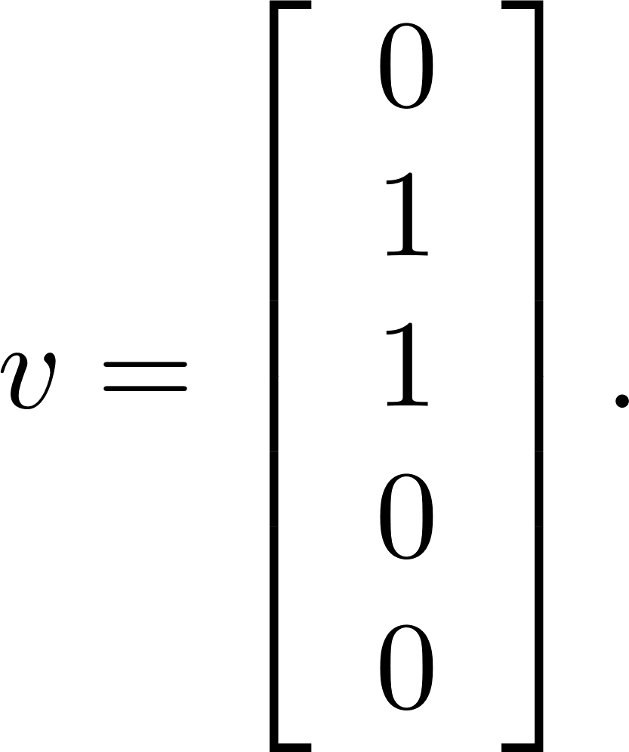

Divide-and-Conquer Method 5 5 Example
Write as

Slide 58
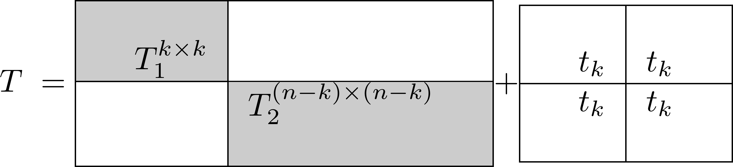
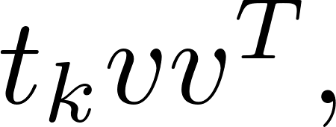
Divide-and-Conquer Method n n Case

Slide 59

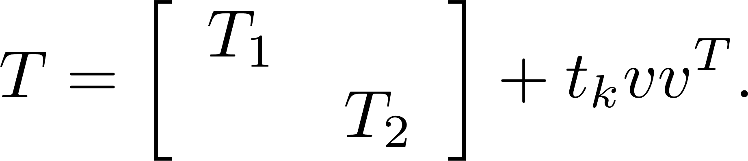
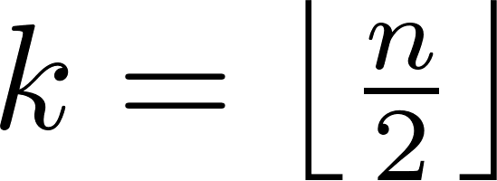

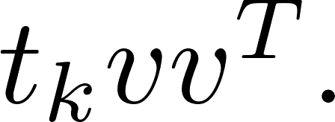
Algorithm dconquer
Split the symmetric tridiagonal matrix T into the sum of a 2 × 2 block symmetric tridiagonal matrix and a rank-one correction matrix and return the eigenvalues and eigenvectors of T.
Let and form
Compute
Form V and D from and

Slide 60



Algorithm dconquer
By the spectral theorem Let T is similar to whose eigenvalues are the solutions of the secular equation

Slide 61
Algorithm dconquer
dconquer is more than twice as fast as the QR algorithm if both eigenvalues and eigenvectors of a symmetric tridiagonal matrix are required.
The book software uses the mex function. mex filename compiles and links a C, C++, or Fortran source file into a binary MEX-file, callable from MATLAB.

Slide 62

Example 6

